Slide 1

 | Kebijakan (policy) | Doc. No :
 | SEAM SEALING STANDARD PROCEDURE | Page | 01 of 29
 |  | Date of making | 02 Desember 2022
 |  | Date of revise | 18 September 2025
 |  | Revise No. | 03
Tugas Kerja QC Tes Air & Materi
(jenis-jenis bocor, nama - nama body di tes air, macam-macam defect selain bocor)

Slide 2

Waterproof Test Standard (Standar Tes Air)
Waterproof Test Machine (Mesin Tes Air)
TNF, K-JUS, & KATHMANDU Waterproof Test Form (Laporan Tes Air TNF, K-JUS & KATHMANDU)
Steps To Do By The Waterproof Test QC If There Is Leaking (Langkah – Langkah Yang Harus Dilakukan Oleh QC Tes Air Bila Terjadi Bocor)
The Waterproof Test QC Noted Cross Ba Sewing Target/Hour (QC Tes Air Mencatat Target Sewing Cross Ba Per Jam)
Kinds of Leakage (Jenis – Jenis Bocor)
Kinds of Defect that should be repaired (Jenis – Jenis Defect Harus Diperbaiki)
Name of Body Parts in Garment For Waterproof Test (Nama – Nama Bagian Body Untuk Tes Air)
CONTENTS

Slide 3
Waterproof Test Standard (Standar Tes Air)
Waterproof Test Checking Time Standard (Standar Waktu Pengecekan Tes Air)
  2 minutes for tape non gore-tex & storm. (2 menit untuk tape non gore-tex & storm)
  1 minute for gore-tex & light rain, future light tape. (1 menit untuk tape gore-tex & light rain, future light
Pressure Waterproof Test Standard (Standar Tekanan Test Air)
  3 PSI for tape non gore-tex & storm. (3 PSI untuk tape non gore-tex & storm)
  1,5 PSI for gore-tex & light rain, future light tape. (1,5 PSI untuk tape gore-tex & light rain, future light)

Slide 4
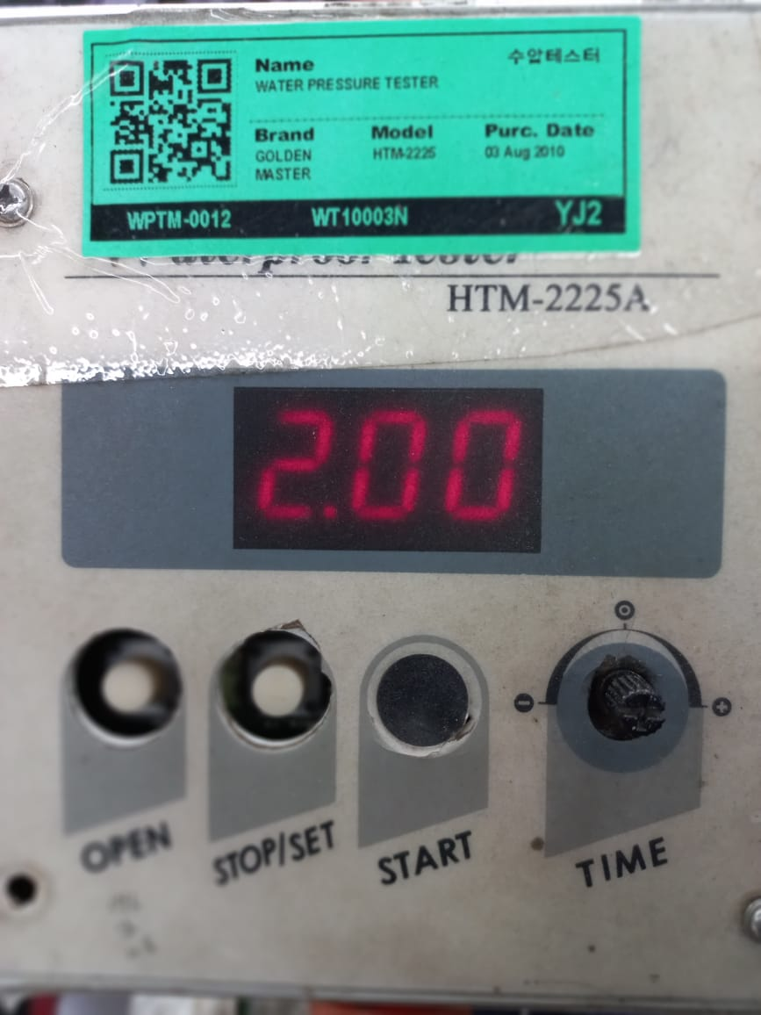
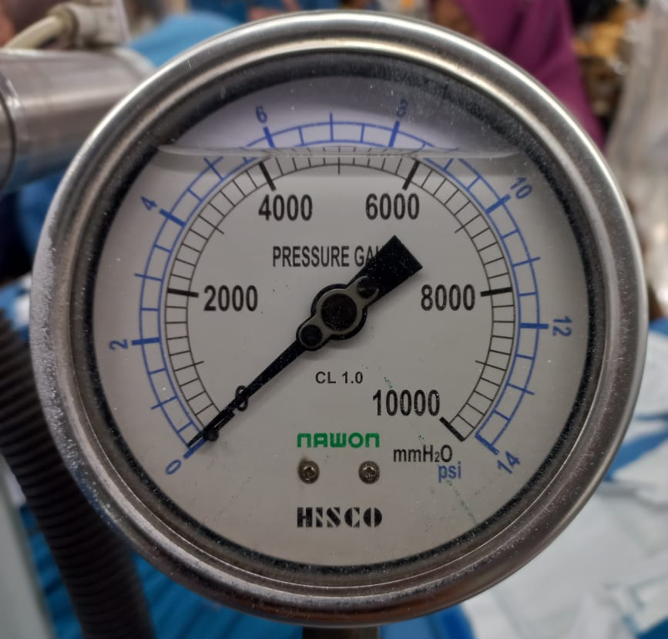
Waterproof Test Machine (Mesin Tes Air)
Time (Waktu)
  Mechanic setting usage time standard 1 to 2 minutes. (mekanik setting waktu pemakaian standar 1 atau 2 menit)
Pressure (Tekanan)
  The QC waterproof test setting the water faucet for deciding 1,5 PSI or 3 PSI. (Operator QC tes air mengatur kran air untuk menentukan 1,5 PSI atau 3 PSI)
  Filling/reducing water at least 2 times a day. (Pengisian/penggantian air minimal 2 kali dalam sehari)
  The water for waterproof test should not in a hot condition. (Air untuk tes air tidak boleh dalam keadaan panas)

Slide 5
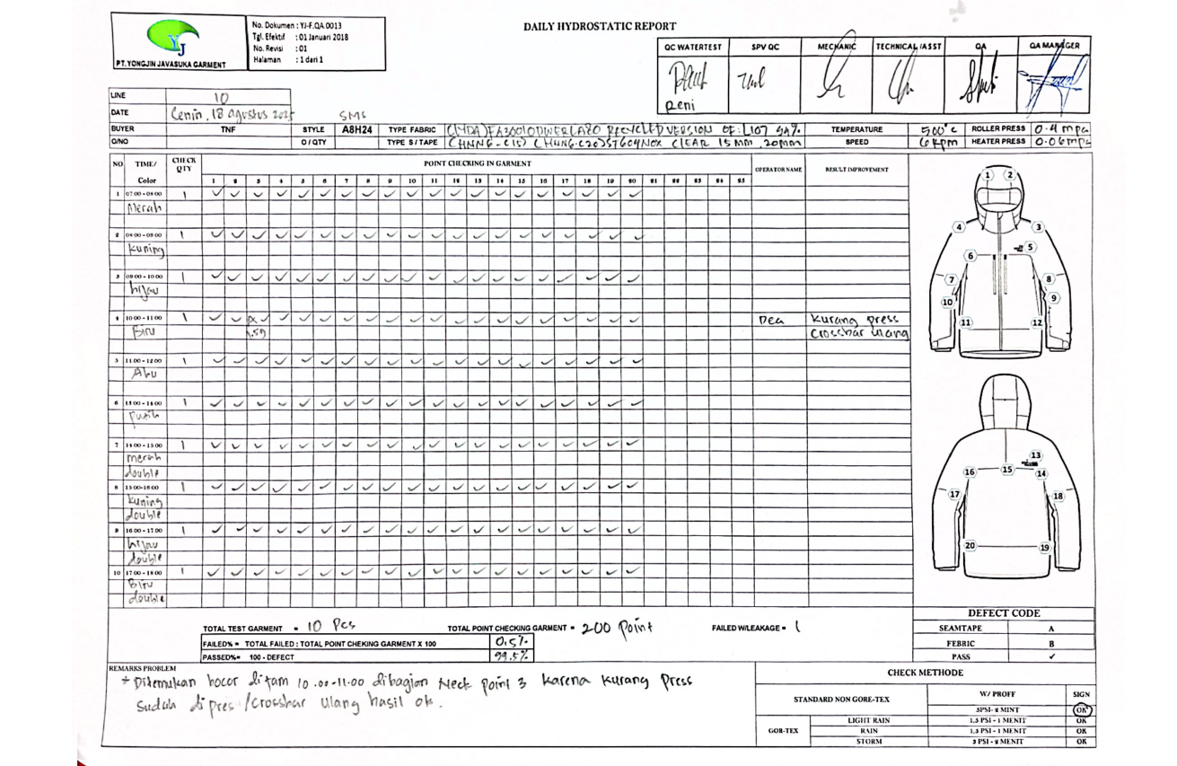
TNF, K-JUS, & KATHMANDU Waterproof Test Form (Laporan Tes Air TNF, K-JUS, & KATHMANDU)

Slide 6
Filling in report form TNF, K-Jus, Kathmandu (Pengisian laporan TNF, K-Jus, Kathmandu)
  Line & Date Column: Write for the Line and Date based on which Line and when the waterproof test is conducted. (Kolom Line & Tanggal: Tulis Line dan Tanggal sesuai dengan Line mana dan kapan pelaksanaan tes air)
  Column fabric, tape, temperature, speed, nozzle: See the BOM and data in the seam sealing machine. (Kolom fabric, tape, temperature, speed, nozzle: Lihat pada BOM dan data di mesin seam sealing)
  Column QTY Check: The waterproof test QC should count the time needed for checking 1 garment, for example, 19 points X 2 minutes = 38 minutes / PCS garment. (Kolom cek QTY: QC tes air harus menghitung waktu yang diperlukan untuk pengecekan 1 garment, contoh, 19 menit X 2 menit = 38 menit/PCS garment)
  Waterproof test time 60 minutes: 38 minutes = 1 pcs with 20 minutes remaining, then in the check QTY column write 1 pcs(garment for the waterproof test in column time/60 minutes. (waktu tes air 60 menit: 38 menit = 1 pcs dengan sisa waktu 20 menit, maka dikolom check QTY ditulis 1 pcs(garment yang akan dites air oleh QC tes air dalam kolom waktu/60 menit))

Slide 7
  Column numbers 1,2,3...etc: See the checking result while the waterproof test is conducted based on point number & the standard. (Lihat dari hasil pengecekan saat tes air berjalan sesuai nomor point & standard)
  - With checklist mark for non-leaking points. (Dengan tanda ceklis untuk point yang tidak bocor)
  - With units of minutes and seconds for leaking points. (Dengan satuan menit dan detik untuk point bocor)
  Column total test garment: fill with the amount of total QTY checking garment from morning until return time. (Kolom total test garment: isi dengan jumlah total QTY checking garment dari pagi sampai jam pulang)
  Column total point checking garment: fill with the amount of points in 1 garment X total quantity checking. (Kolom total point checking garment: isi dengan jumlah point dalam 1 garment X total quantity checking)
  Column Failed/Leakage: fill with the amount of leaking points. (Kolom Failed/Leakage: isi dengan jumlah point yang bocor)
  Column Failed%: fill with counting ’Leak: total point checking garment X 100’. (Kolom Fail%: isi dengan menghitung ’Bocor: total point checking garment X 100’)
  Column passed%: fill with counting 100% - column fail% result. (Kolom passed%: isi dengan jumlah 100% - hasil kolom fail%)

Slide 8
  At each hour of checking, 1 rapia is marked with a different color and at the 7th hour onwards it is marked with 2 rapia of the same color (double rapia) and the rapia color information will be written manually in the checking report (Di setiap jam pengechekan diberikan tanda 1 tali rapia dengan warna yang berbeda dan di jam ke-7 sampai seterusnya itu ditandai dengan 2 tali rapia dengan warna yang sama ( double rapia ) dan informasi warna rapia akan ditulis manual di dalam report pengechekan.)

Slide 9
Checking the waterproof test report form received before the waterproof test (Pengecekan form laporan tes air yang diterima sebelum tes air)
  See the points number in the waterproof test report (lihat point-point nomor di laporan tes air)
  Adjust the style number, the garment buyer to be waterproof tested with the report form that will be filled in. (sesuaikan nomor style, nama buyer garment yang akan dites air dengan form/laporan yang akan di isi)
  The drawing or sketch of the garment that is in the waterproof test report must be matched with the actual garment for which the waterproof test will be carried out. (gambar/sketsa garment yang ada dilaporan tes air harus dicocokkan dengan aktual garment yang akan dilakukan tes air)
  Then match the points to be in the waterproof test that are in the form / waterproof test report with the garment, appropriate or not. (Kemudian cocokkan point yang akan di tes air yang ada diform/laporan tes air dengan garment, sesuai atau tidak)

Slide 10
Checking the waterproof test report form received before the waterproof test (Pengecekan form laporan tes air yang diterima sebelum tes air)
  Points in the waterproof test are in text form (point yang di tes air dalam bentuk tulisan)
  Straight : (Lurus)
  Curve : (Lengkung) (hood, armhole/raglan)
  2-way cross : 2 times seam sealing process, example neck, armhole with joint sleeve (2X jalan dalam proses seamsealing, contoh neck, armhole dengan joint tangan)
  3-way cross : 3 times seam sealing process, example armpit, crocth, back yoke (3X jalan dalam proses seamsealing, contoh armpit, crocth, back yoke)
  Fabric : Waterproof test is just for fabric not for the seam (Tes air dilakukan hanya di fabric/bukan pada seam)
  Embroidery : Waterproof test in Logo not the print (Tes air dibagian logo bukan print)

Slide 11
Steps To Do By The Waterproof Test QC If There Is Leaking
(Langkah – Langkah Yang Harus Dilakukan Oleh QC Tes Air Bila Terjadi Bocor)
  The waterproof test QC write the time in minutes / seconds when leaking happens in waterproof test report form. (QC tes air menulis menit/detik waktu terjadi bocor di form/laporan tes air)
  The waterproof test QC continue the test until the last point in garment, finish 1 garment. (QC tes air melanjutkan tes air sampai point terkahir pada point garment, selesai 1 garment)
  The waterproof test QC should inform the leakage to the seam sealing mechanic, chief sewing/supervisor sewing. (QC tes air harus melaporkan bocor pada mekanik seam sealing, chief sewing/ supervisor sewing)
  QC water test must re-call the entire quantity produced by cross ba operator at the time ot the leak discovery to be tested for water at the point that leaked and on the garment in the same raffia color. (QC test air harus melakukan re-call seluruh quantity yang dihasilkan oleh operator cross ba di jam ditemukannya bocor untuk di tes air di point yang bocor dan pada garment di warna tali rafia yang sama)
  After the QC water test conducted a recall, garments that had already gone through the QC Endline process were not recalled at the time the leak was discovered. After the QC water test conducted a recall, garments that had already gone through the QC Endline process were not recalled at the time the leak was discovered. (Setelah QC tes air melakukan re-call, garment yang sudah berjalan ke proses QC Endline itu tidak dilakukan re-call pada jam ditemukannya bocor)

Slide 12
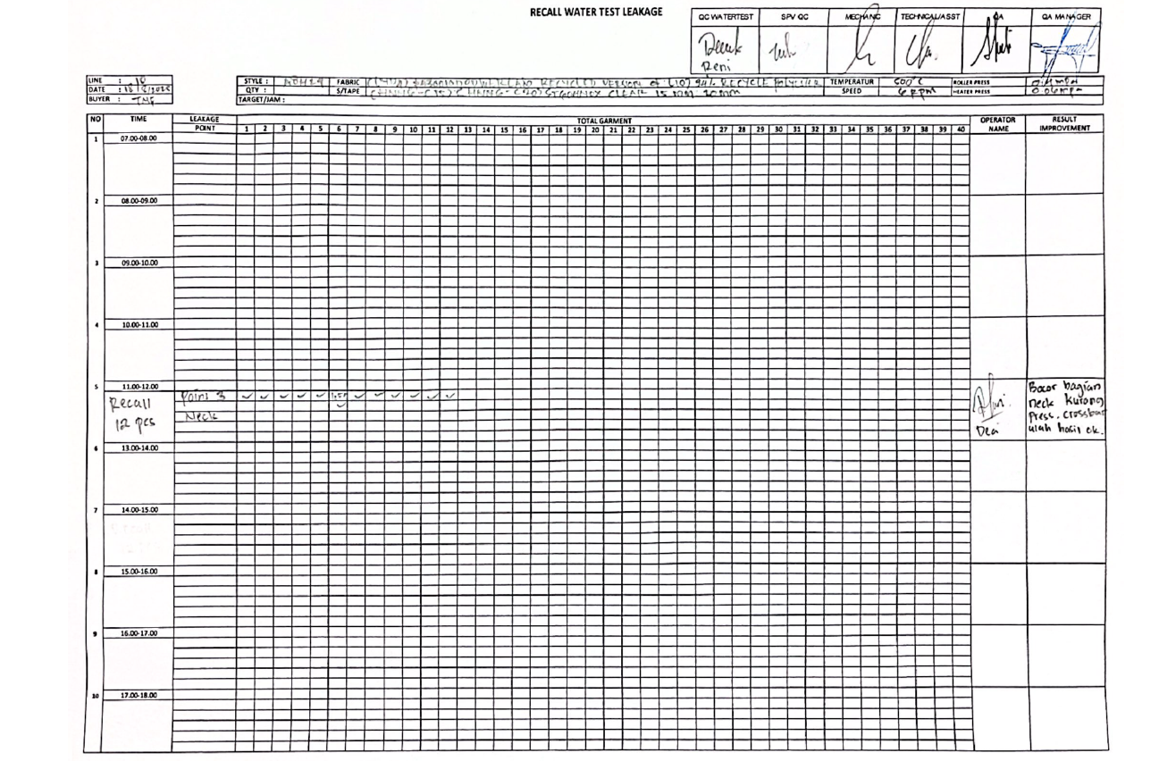

Slide 13
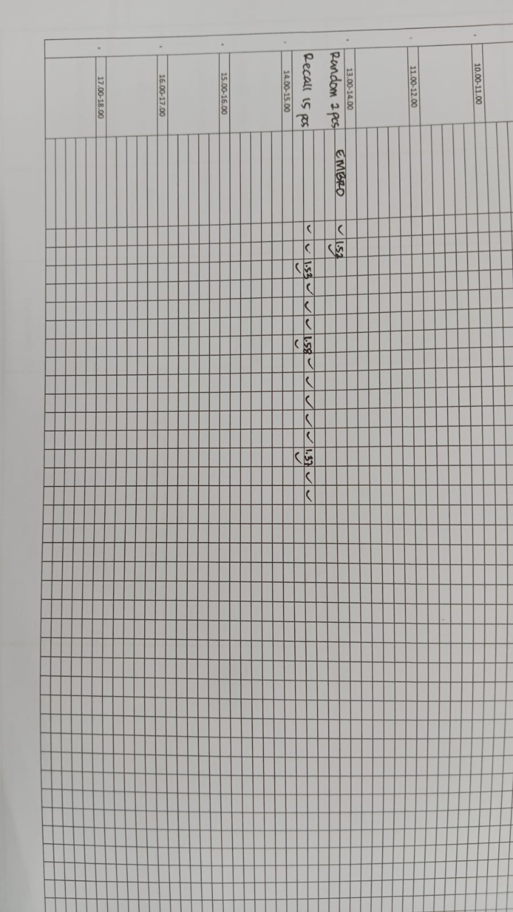
How to Fill Out the Recall Report If Leaking Happen In Embroidery Logo (Cara Pengisian laporan Recall Bila Terjadi Bocor di Logo)
  If there is leaking, the waterproof test QC do random 2 pcs, if in that random found the leakage then the waterproof test QC should do recall from hour target cross ba, the same with leakage at seam sealing. In the next hour, there is no random test again because the embroidery division will do repair all embroidery that is in the Line.
  (Bila terjadi bocor, maka QC tes air random 2 pcs dan bila dari random tersebut ditemukan bocor lagi maka QC tes air harus melakukan recall target 1 jam dari sewing cross ba, di jam berikutnya tidak dilakukan random lagi karena pihak embroidery akan melakukan perbaikan seluruh embro yang ada di Line)

Slide 14
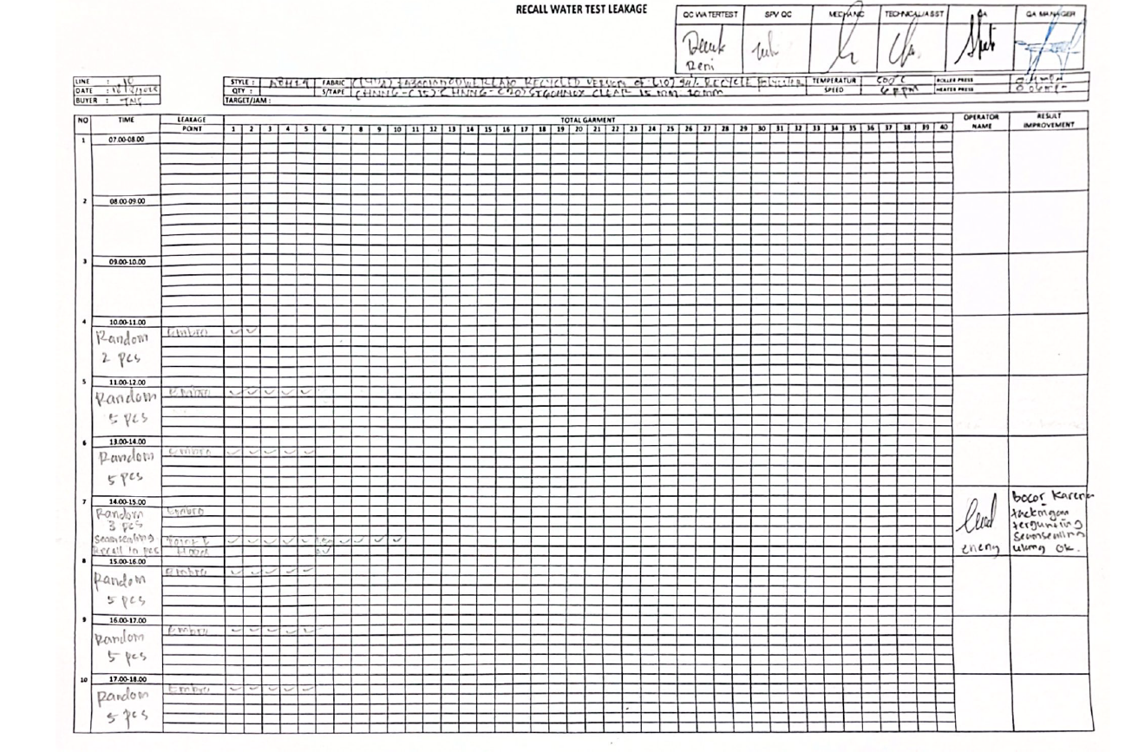
Report Recall Embroidery Logo

Slide 15
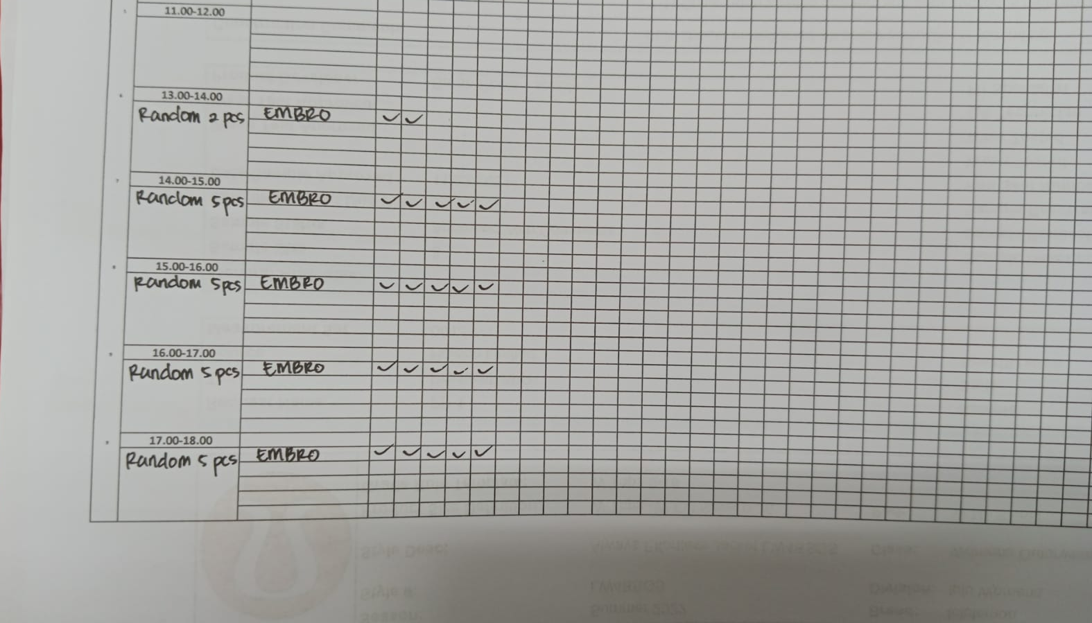
  If there is leaking, the waterproof test QC do random 2 pcs, if in that random test the results is OK, then the waterproof test QC do 5 pcs random in the next hours until return time. (Bila terjadi bocor, maka QC tes air random 2 pcs dan bila dari random tersebut hasilnya oke tidak ada bocor, maka QC tes air melakukan 5 pcs random terus menerus hingga jam pulang)

Slide 16
  If there is leaking, the waterproof test QC do random 2 pcs, if the results of random is OK then the waterproof test QC do 5 pcs random in the next hours. If the next hour found again the leakage from 5 pcs random, the waterproof test QC should recall. In the next hours there is no random test again because the embroidery division will do repair all embroidery that is in the Line. (Bila terjadi bocor, maka QC tes air random 2 pcs dan bila hasil dari random tersebut oke, maka QC tes air melakukan random 5 pcs di jam berikutnya, bila dari random 5 pcs ditemukan bocor seam tape maka QC tes air harus melakukan recall. Di jam berikutnya tidak dilakukan random lagi karena pihak embroidery akan melakukan perbaikan seluruh embro yang ada di Line)

Slide 18
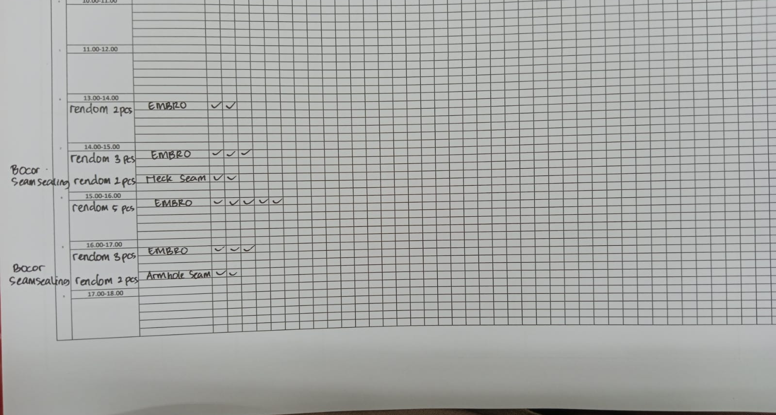
  If there is leaking, the waterproof test QC do random 2 pcs, if the results of random is OK then the waterproof test QC do 5 pcs random in the next hours. If the next hour also found the seam sealing leakage then the random is reduces to 3 pcs random, and continue to random check seam sealing leakage as usual. (Bila terjadi bocor, maka QC tes air random 2 pcs dan bila hasil dari random tersebut oke, maka QC tes air melakukan random 5 pcs di jam berikutnya, bila dari seam sealing ditemukan bocor juga maka dikurangi untuk tes embroidery menjadi 3 pcs, dan selanjutnya recall cek untuk seam sealing seperti biasa)

Slide 19
The Waterproof Test QC Noted Cross Ba Sewing Target/Hour (QC Tes Air Mencatat Target Sewing Cross Ba Per Jam)
  In the first hour, the waterproof test QC take garments that will be tested with the raffia rope from cross ba target last hour in yesterday. (Di jam pertama QC Test air mengambil garment dengan warna tali rafia yang sama dengan crossba)
  In the second hour, QC water testing took garments with raffia straps of the same color as the target cross ba in the second hour.(Di jam kedua, QC tes air mengambil garment dengan warna tali rafia yang sama dengan target crossba di jam kedua )
  The waterproof test QC / cross ba operator should noted the total quantity results cross ba target/hour, for easier the waterproof test QC in counting number of garment that will be recall when leaking happen & results of random still found leaking. (QC tes air/ operator cross ba harus mencatat total quantity hasil target cross ba/jam, untuk memudahkan QC tes air dalam pengambilan jumlah garment yang akan di recall, ketika ditemukan kebocoran pada pengetesan pertama)

Slide 20
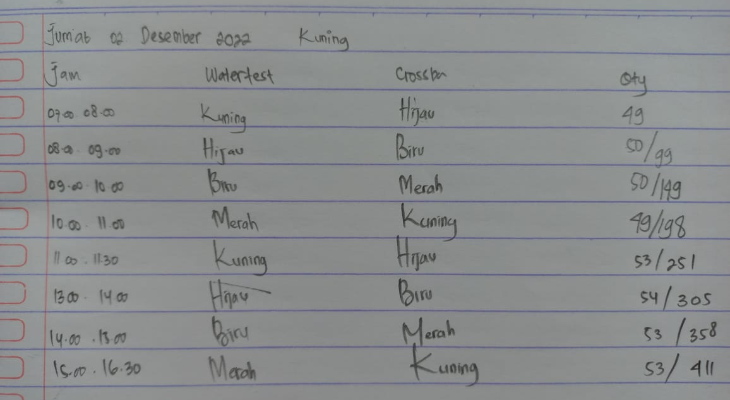
The Waterproof Test QC Noted Cross Ba Sewing Target/Hour (QC Tes Air Mencatat Target Sewing Cross Ba Per Jam)

Slide 21
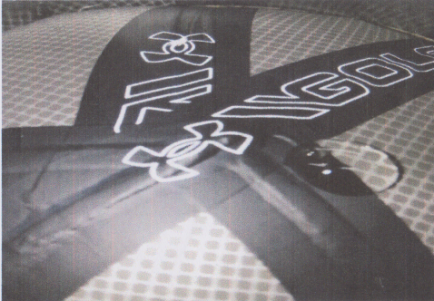
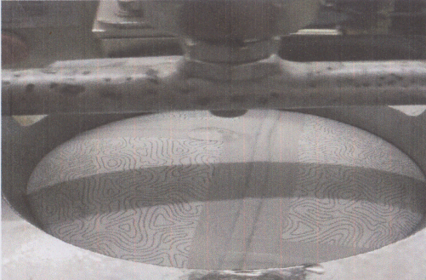
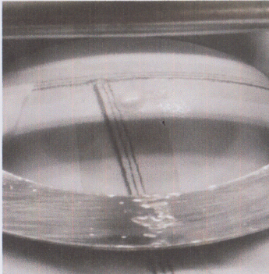
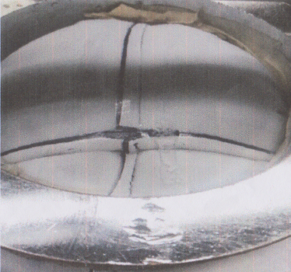
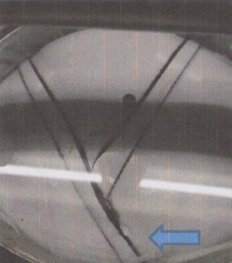
Kinds of Leakage (Jenis – Jenis Bocor)
Less Pressure Tape (Tape kurang press)
Broken Tape, leaking in the middle of the seam/tape (Tape sobek, bocor ditengah jahitan/tape)

Slide 22
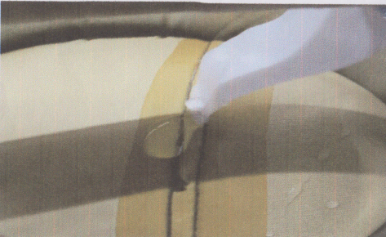
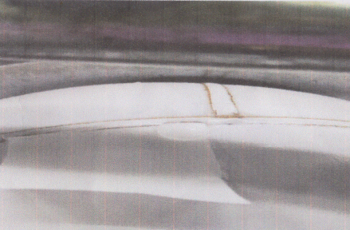
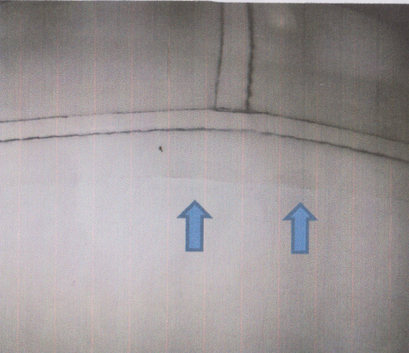
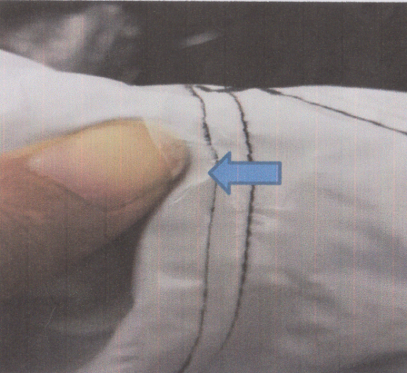
Trimmed tape tacking (Tape tacking tergunting)
Tape peel off (Tape terkelupas)

Slide 23
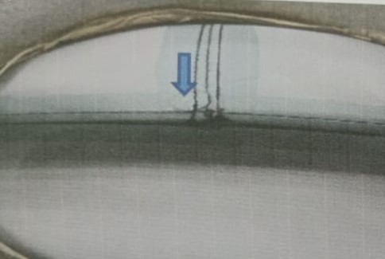
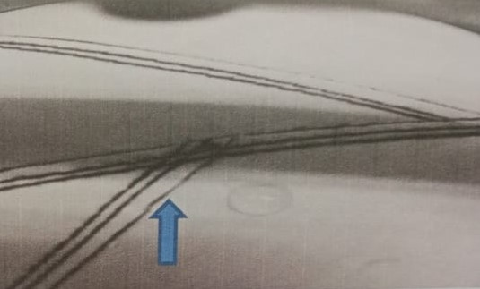
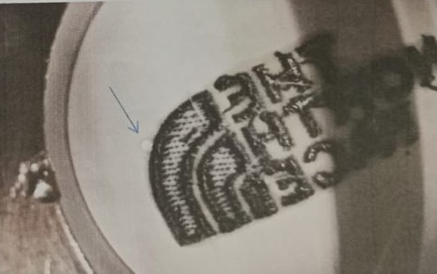
Pleated tape (Tape terlipat)
Broken Tape Bemis (Tape bemis sobek)

Slide 24
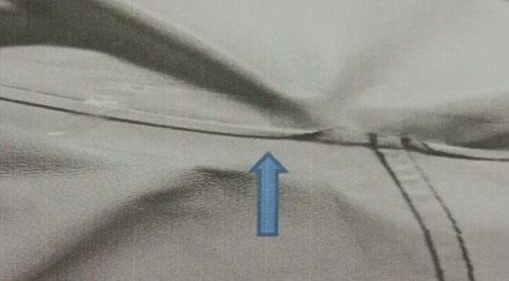
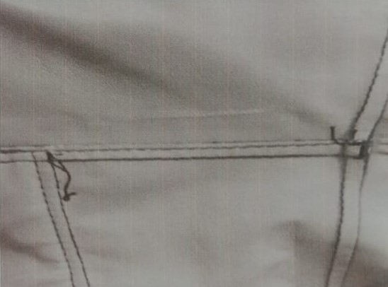
Kinds of Defect that should be repaired (Jenis – Jenis Defect Harus Diperbaiki)
Pleated seam allowance (Seam allowance terlipat)
Unclean Thread before sealing (Benang Tidak Bersih sebelum di sealing)

Slide 25
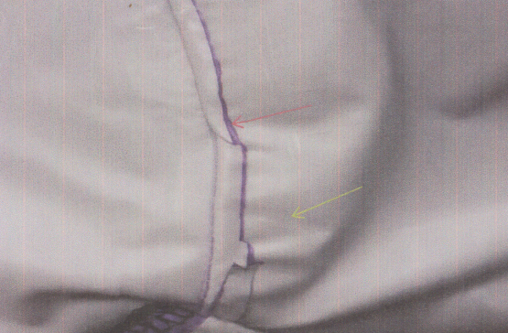
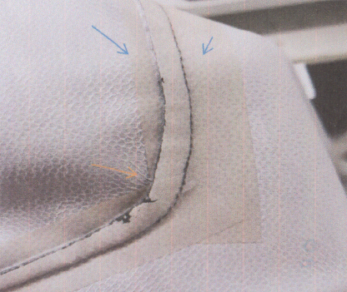
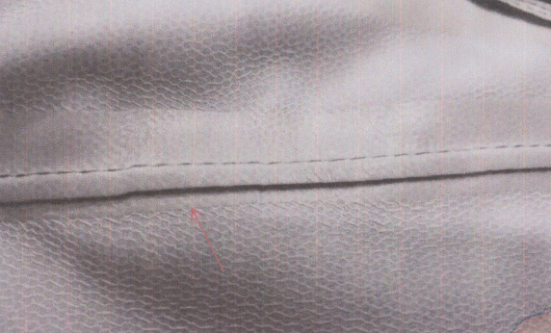
Pleated tape & Seam allowance (Seam allowance dan tape terlipat)
Uncentered tape (Tape tidak center)

Slide 26
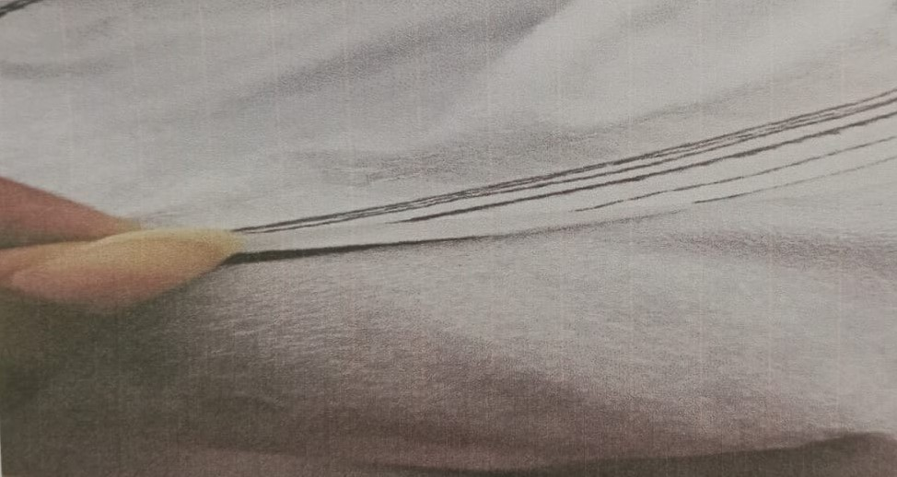
Peel off tape (tape terkelupas)

Slide 27
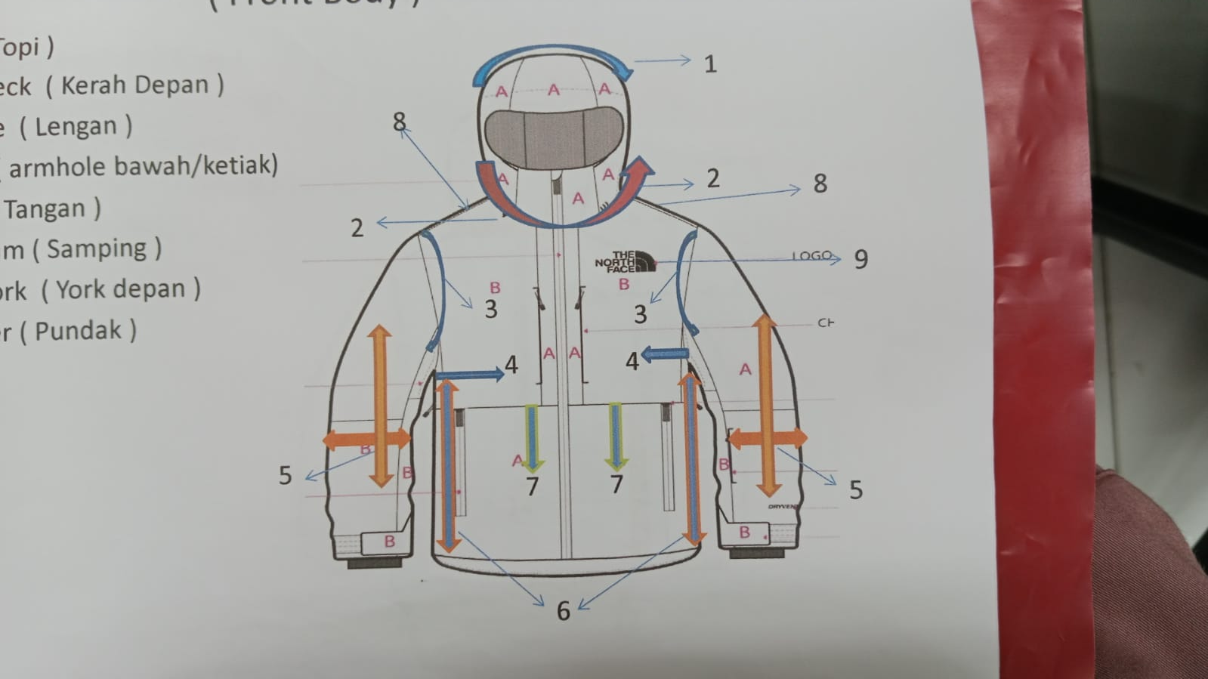
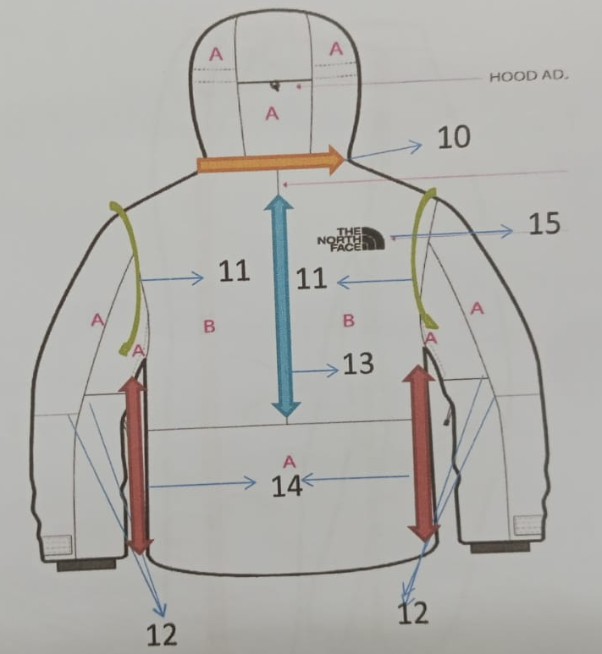
Name of Body Parts in Garment For Waterproof Test (Nama – Nama Bagian Body Untuk Tes Air)
  Front Body (Body Depan)
  1 : Hood (Topi)
  2 : Front neck (kerah depan)
  3 : Armhole (lengan)
  4 : Armpit (Armhole bawah/ketiak)
  5 : Sleeve (tangan)
  6 : Side seam (samping)
  7 : Front Yoke (yoke depan)
  8 : Shoulder (pundak)
  9 : Logo
  Back Body (Body Belakang)
  10 : Back Neck (leher belakang)
  11 : Back Armhole (lengan belakang)
  12 : Sleeve Panel (panel tangan)
  13 : Center Back (belakang)
  14 : Side Seam (samping)
  15 : Logo

Slide 28
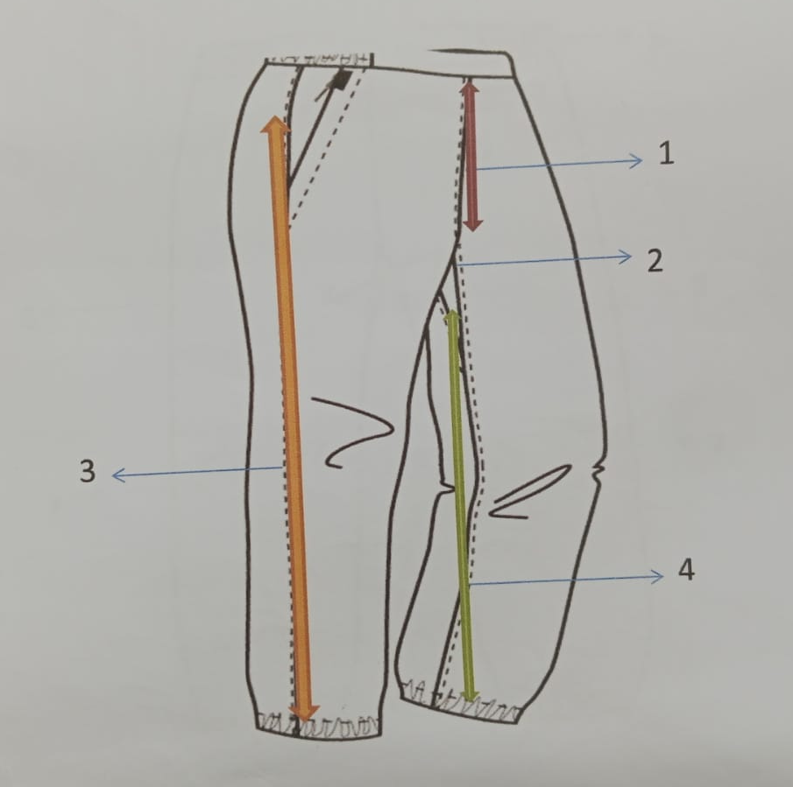
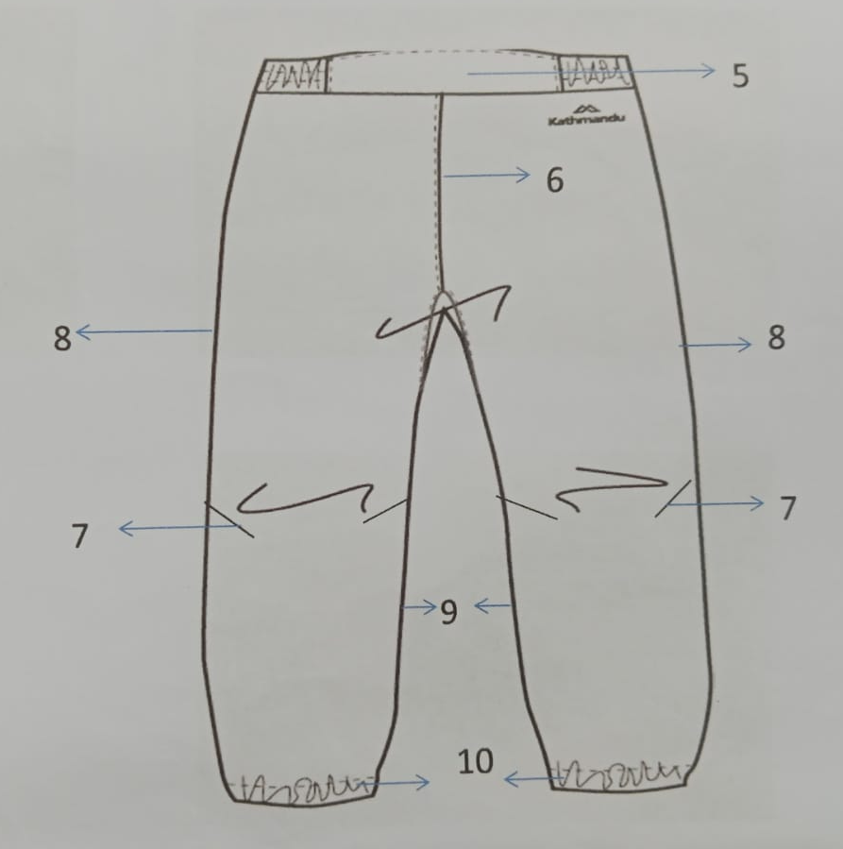
  Front Body (Body Depan)
  1 : Front Raise
  2 : Crotch
  3 : Side seam/Out seam (samping)
  4 : Inseam (jahitan dalam)
  Back Body (Body Belakang)
  5 : Waistband
  6 : Back rise
  7 : Dart/ kupnat (samping)
  8 : Side seam/Out seam (samping)
  9 : Inseam (jahitan dalam)
  10 : Bottom

